Slide 1

Taking Off
Json (Jason), james, michelle, and patrick

Slide 2
Searching for Data
https://transtats.bts.gov/ONTIME/Index.aspx

Slide 3
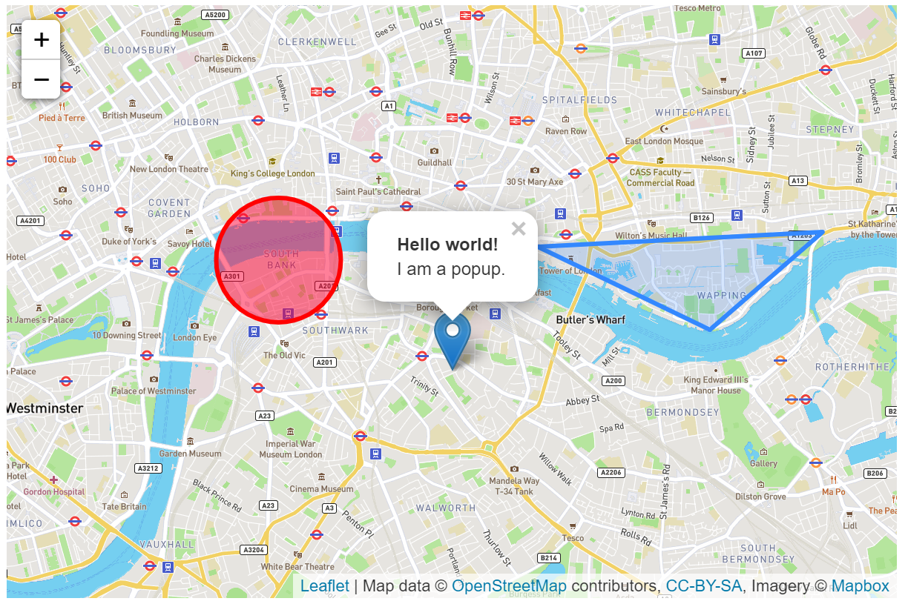
The Inspiration – Leaflet.js
https://leafletjs.com/examples/quick-start/

Slide 4
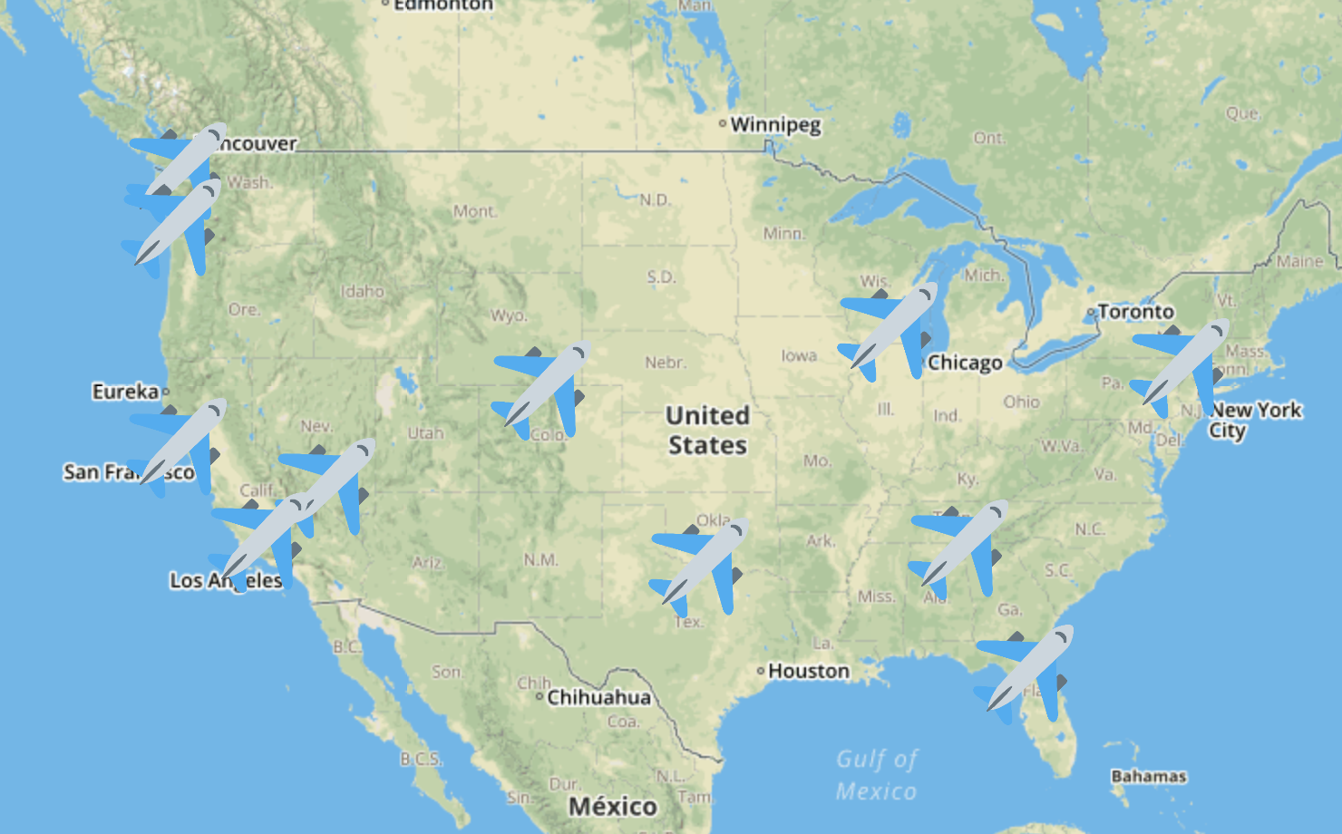
Our Inspiration - Leaflet.js
GOAL: Visualize 10 busiest airports
Use airplane as marker
Hover to show abbreviated airport name
Mouse click to show Popup:
Full airport name
City
State (abbreviation)
Population

Slide 5
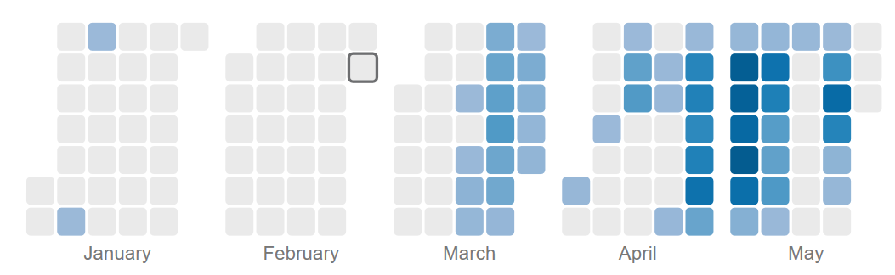
The Inspiration pt. I – Leaflet.js
Show delayed time per date
Hover over - date to show delayed time
Use selector function to filter Airline
Full airport name
City
State (abbreviation)
Population
https://bl.ocks.org/danbjoseph/13d9365450c27ed3bf5a568721296dcc

Slide 6
The Inspiration pt. II

Slide 7
Challenges We Ran Into
Crap load of Data;
2.4 million rows of data
217MB size
494K rows of data

